Slide 1

Dr Mahalingam College of Engineering & Technology
Department of Computer Science and Engineering 141CS0801 - Project Review I
Team Number: 19BCSB18
Domain: Recommendation System [Data Mining]
Title: Crop Recommendation System using Neural Networks
Guide : J.Bhavithra (AP/CSE)
Team Members: M.Sneaha 15BCS076
M.Susilkumar 15BCS094
A.Vignesh 16BCS316
Date: 14/07/2018

Slide 2
Contents
Problem description(domain)
Findings of Literature survey [Detailed Literature survey has to be attached and linked as a separate PPT]
Objective
Overall system Block diagram [ with Implementation Environment]
List of Modules and detailed Module description
Results [Including Datasets and Evaluation metrics]
Snapshots
Publication / Journal Identified Details
References

Slide 3
Literature Identified and Findings
Aitkin, M. and Foxall, R. (2003). Statistical modelling of artificial neural networks using multi-layer perceptron. Statistics and Computing 13, 227–239.MathSciNetCrossRefGoogle Scholar
Alon, I., Qi, M. and Sadowski, R.J. (2001). Forecasting aggregate retail sales: a comparison of artificial neural networks and traditional methods. Journal of Retailer and Consumer Services 8, 147–156.CrossRefGoogle Scholar
Anders, U. and Korn, 0. (1999). Model selection in neural networks. Neural Networks 12, 309–323.CrossRefGoogle Scholar
Barat, C., Loaiza, H., Colle, E. and Lelandais, S. (2000). Neural and statistical classifiers. Can such approaches be complementary? In: Instrumentation and Measurement Technology Conference, Vol. 3, pp. 1480–1486.Google Scholar
Bastos Cavalcante, R. and Ludemir, T.B. (2001). Design of neural networks for time series prediction using case-initialized genetic algorithms. In: Proceedings 8th International Conference on Neural Information Processing, pp. 382–387.Google Scholar

Slide 4
Objective:
The following are the objectives of our proposed idea
To develop a network of clusters using various attributes.
To develop a mining algorithm for analyzing crops and soil factors.
Result from mining will be used to provide recommendation of crops in future.
Crops can thus be cultivated on rotation basis with maximum yield.

Slide 5
Problem Statement:
To improve agriculture the various factors will be made into consideration and the results from them will provide recommendation.

Slide 6
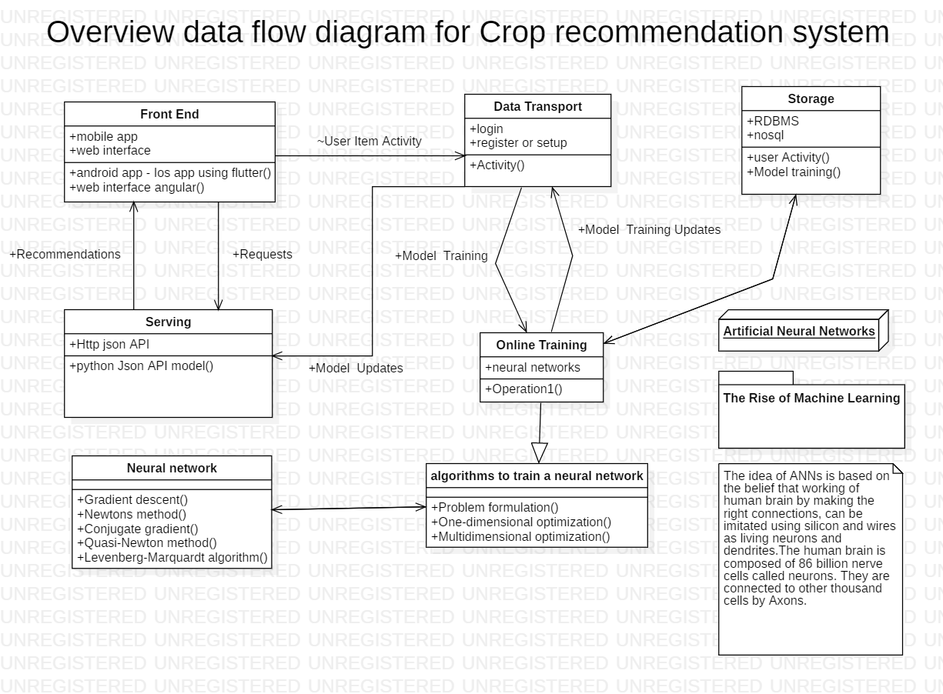
Proposed System with Block Diagram

Slide 7
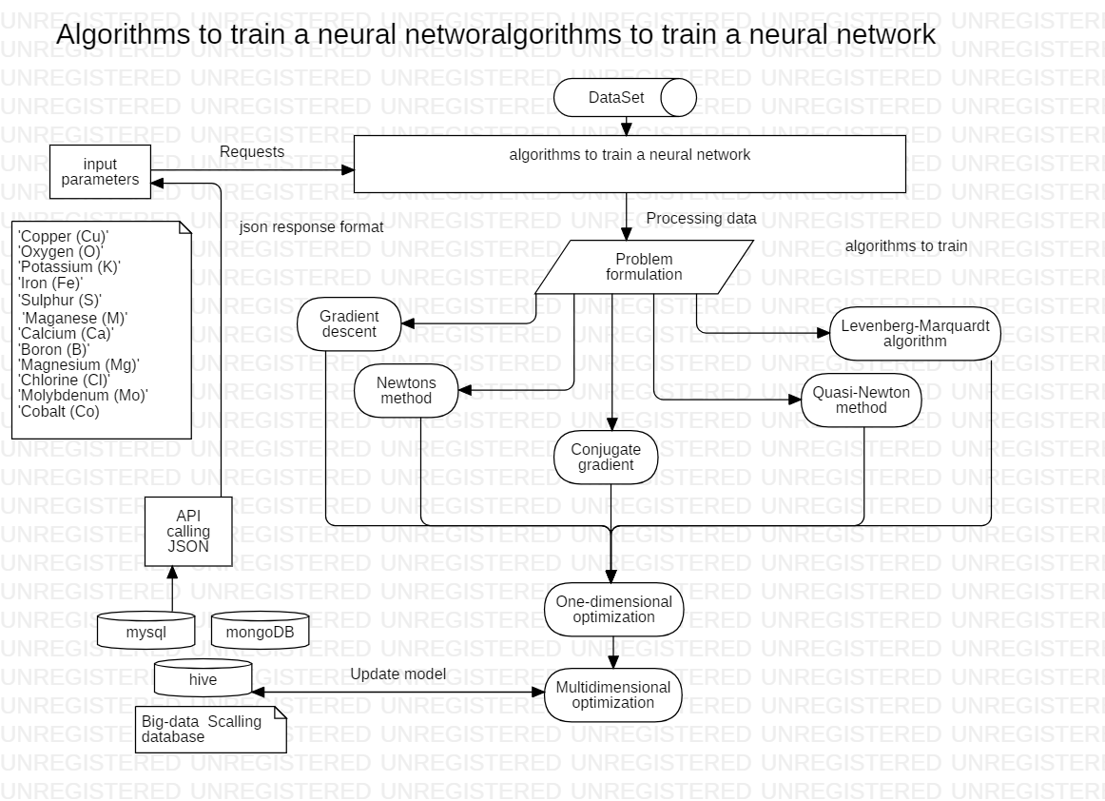

Slide 8
Module Description

Slide 9
MODULE DESCRIPTION
MODULE 1: Interaction Model
Developing all possible utterances, slot values and intents.
MODULE 2: Dynamic storage and Retrieval from DB
Database creation with table that will update itself dynamically (add and remove items).
MODULE 3: Building a neural network
Neural networks is built using various clusters considering all soil and crop factors as attributes.
MODULE 4: Tensor flow convolutional neural network
The tensor flow will provide the work model for the neural network that is the network will be evaluated based on some criteria and the criteria’s should be satisfied to get the result.
MODULE 5: Create API in python using flask
APIs are the tools for making information and application functionality accessible over the internet.

Slide 10
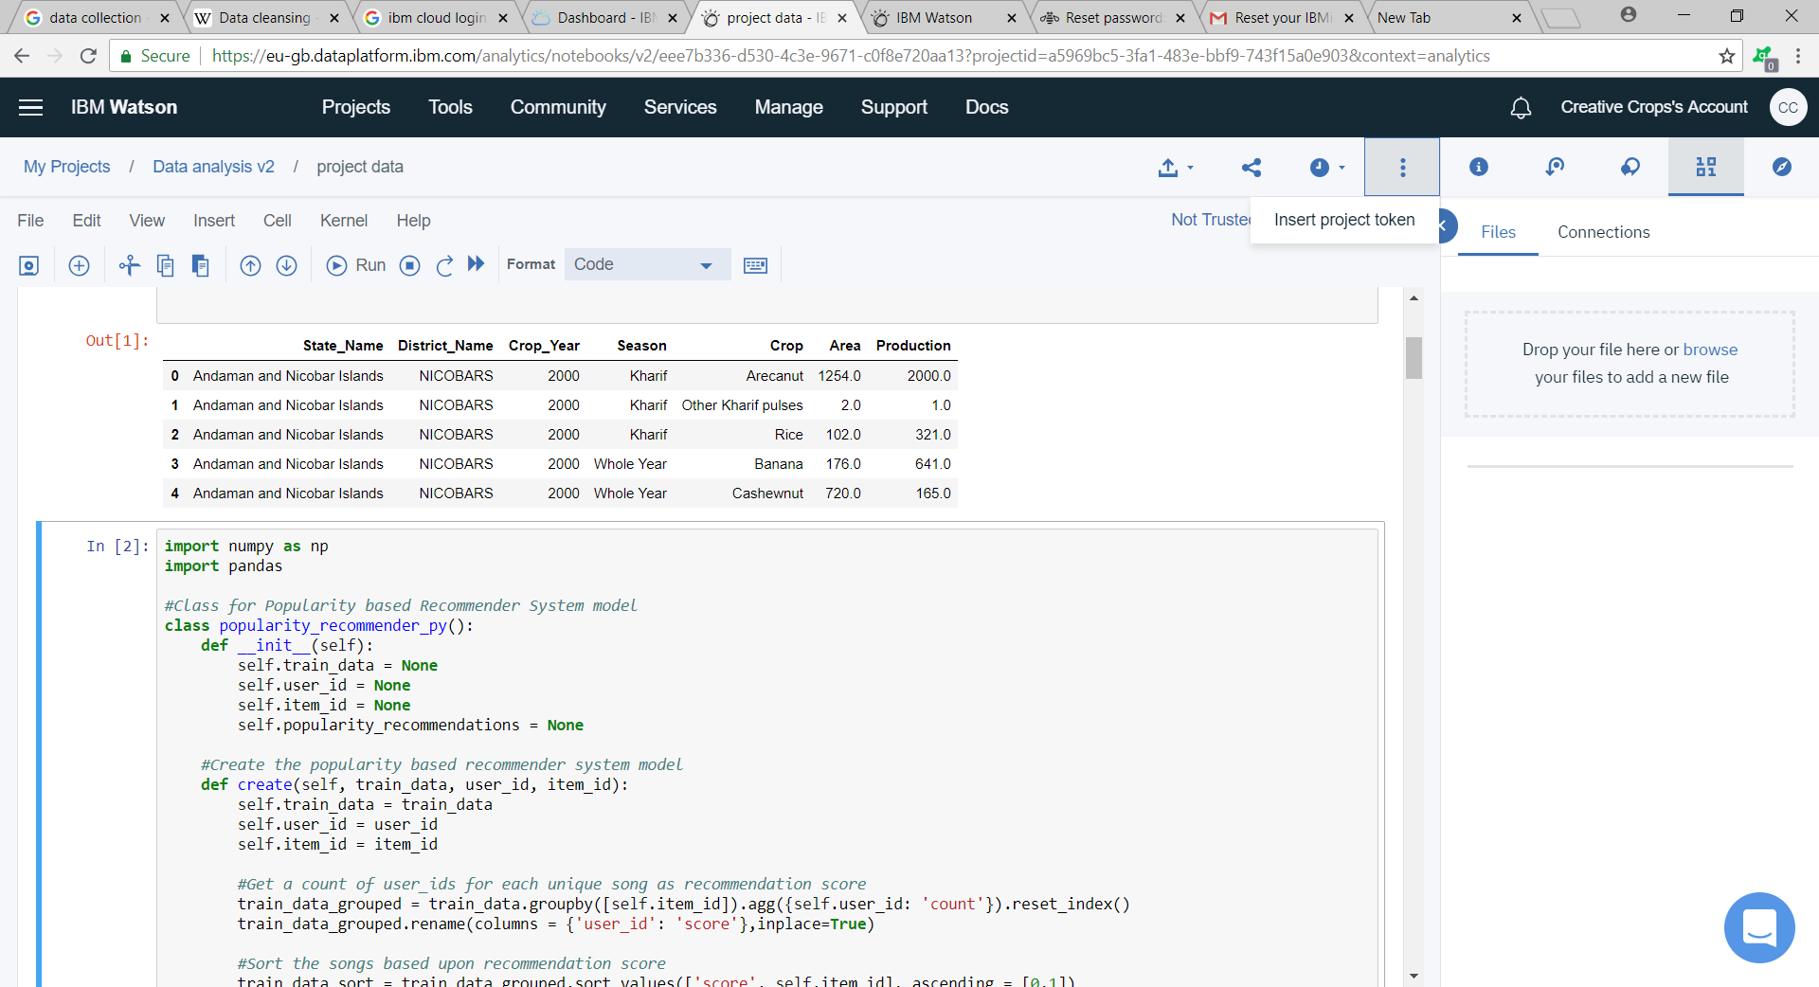
ScreenShots:

Slide 11
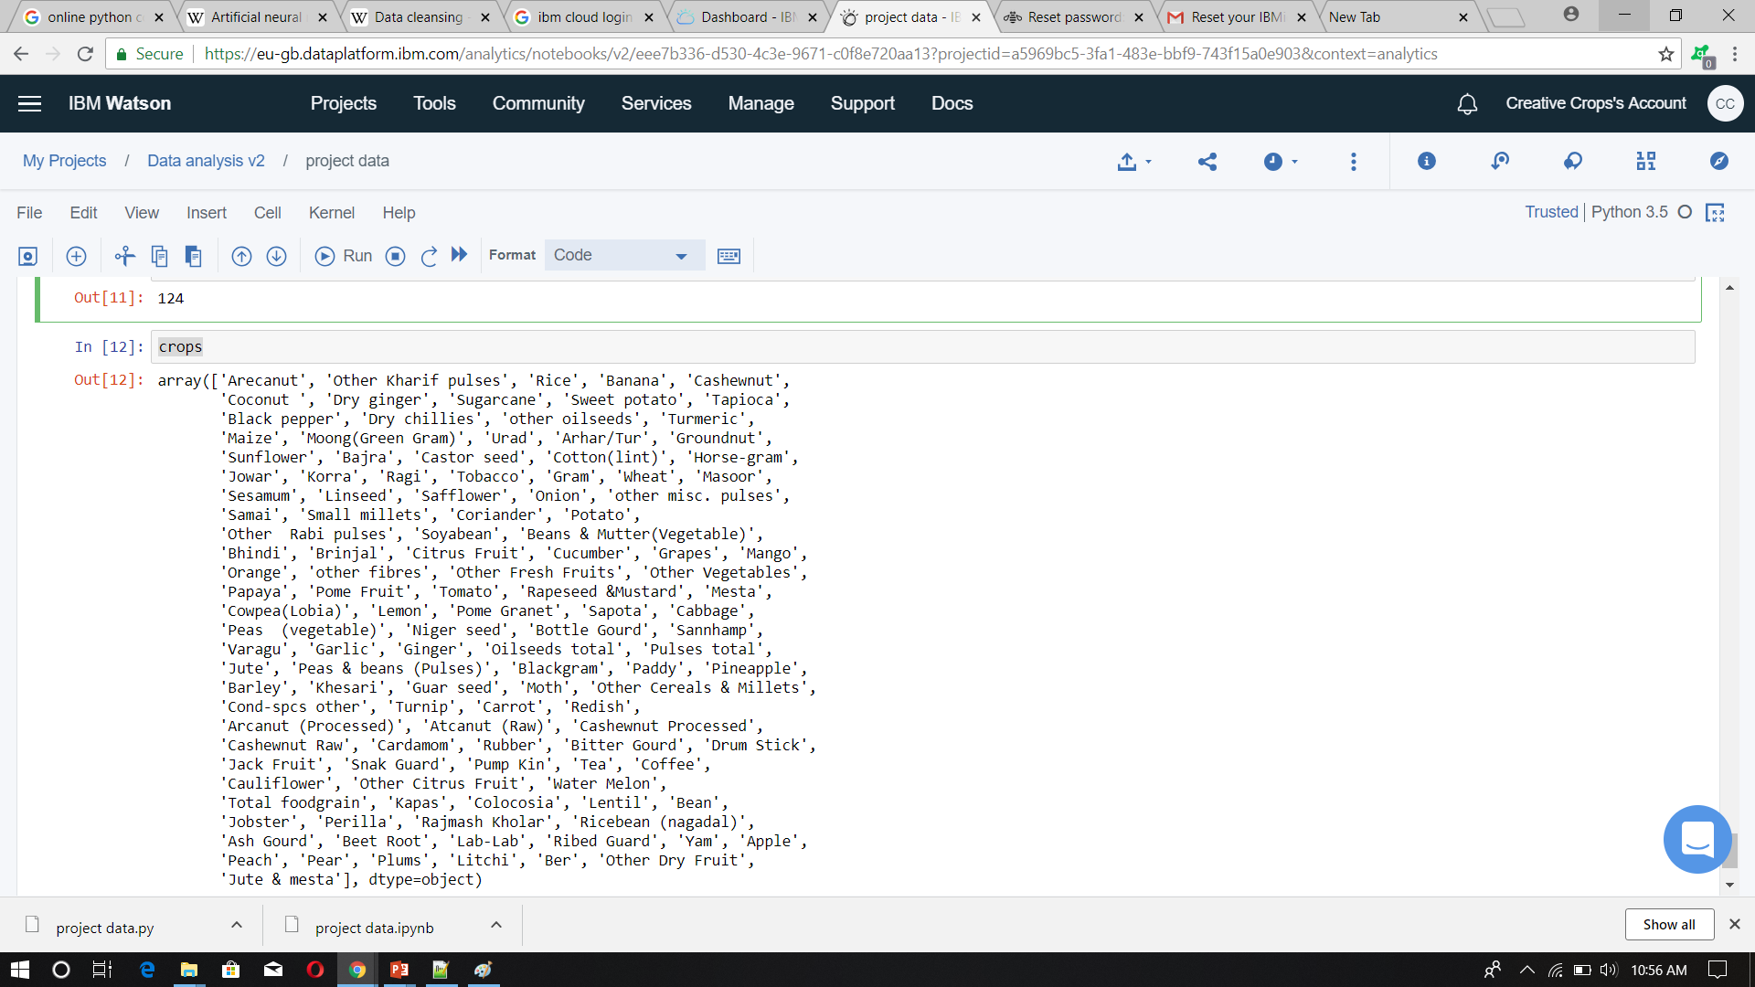

Slide 12
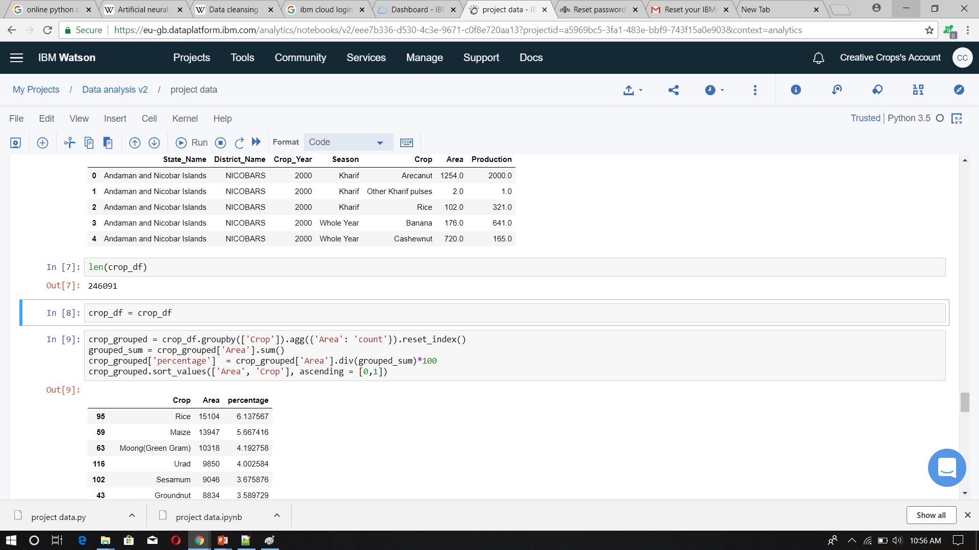

Slide 13


Slide 14


Slide 15


Slide 16
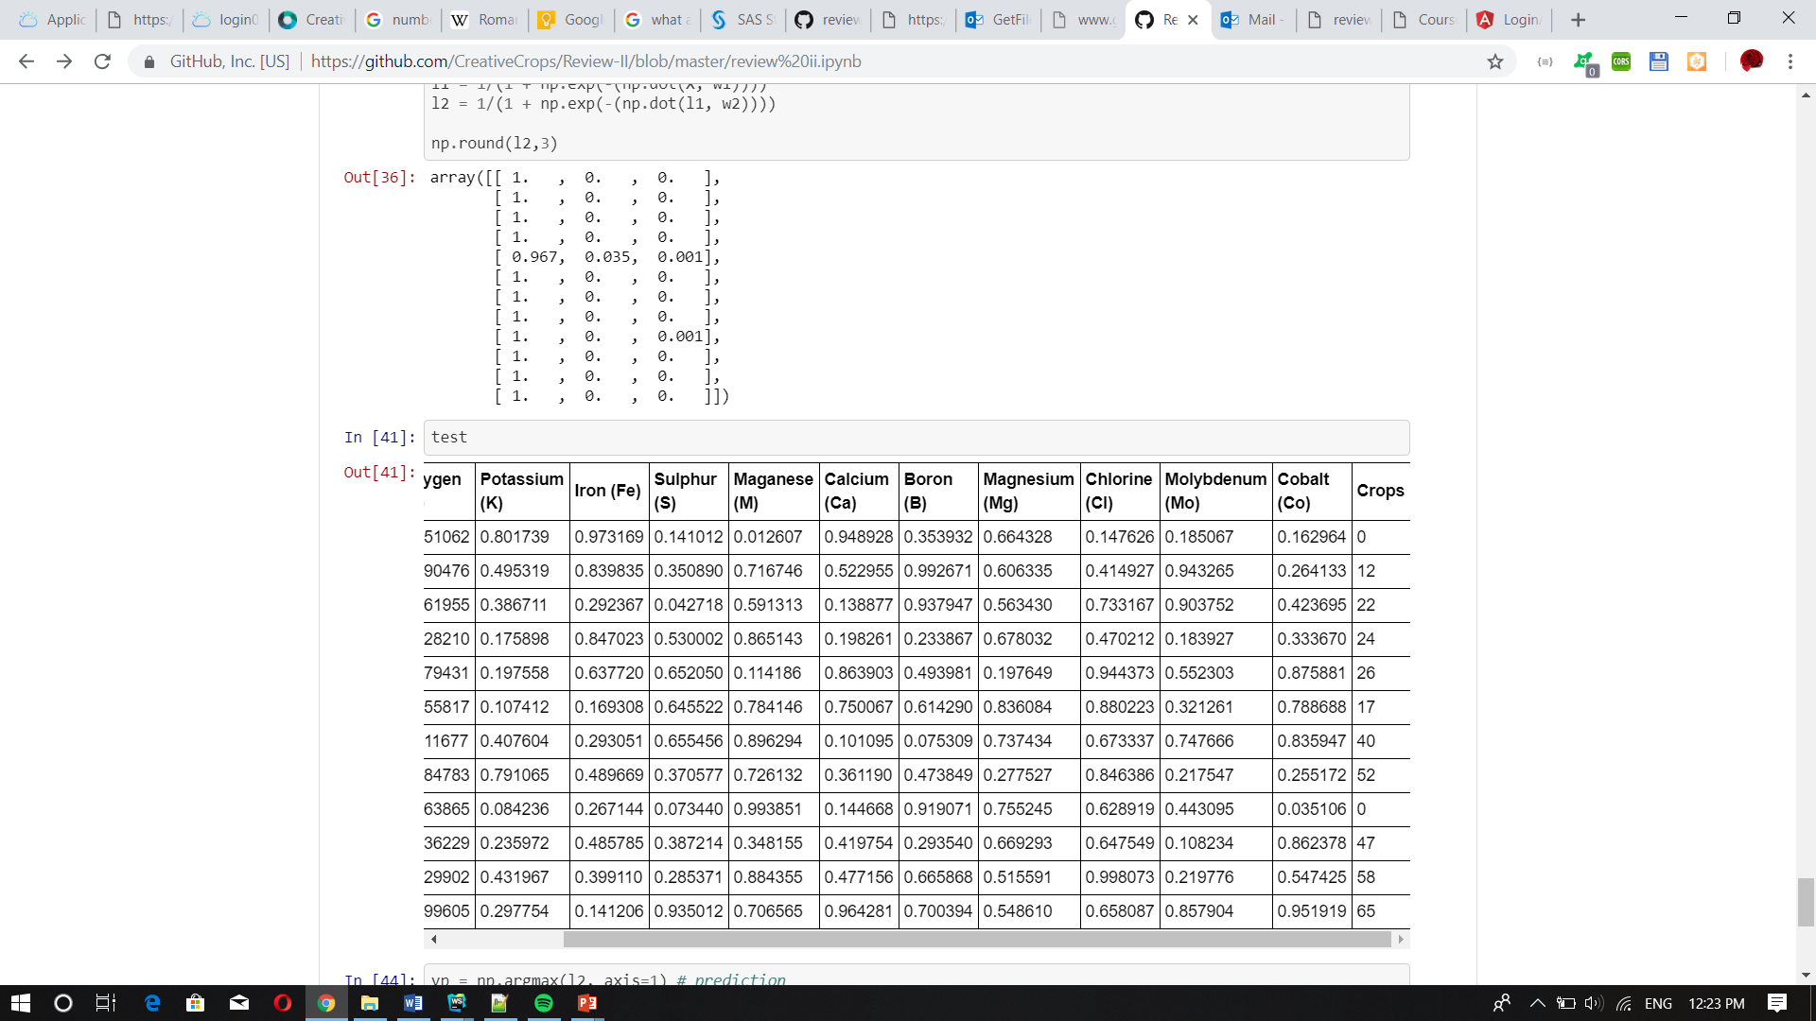

Slide 17


Slide 18
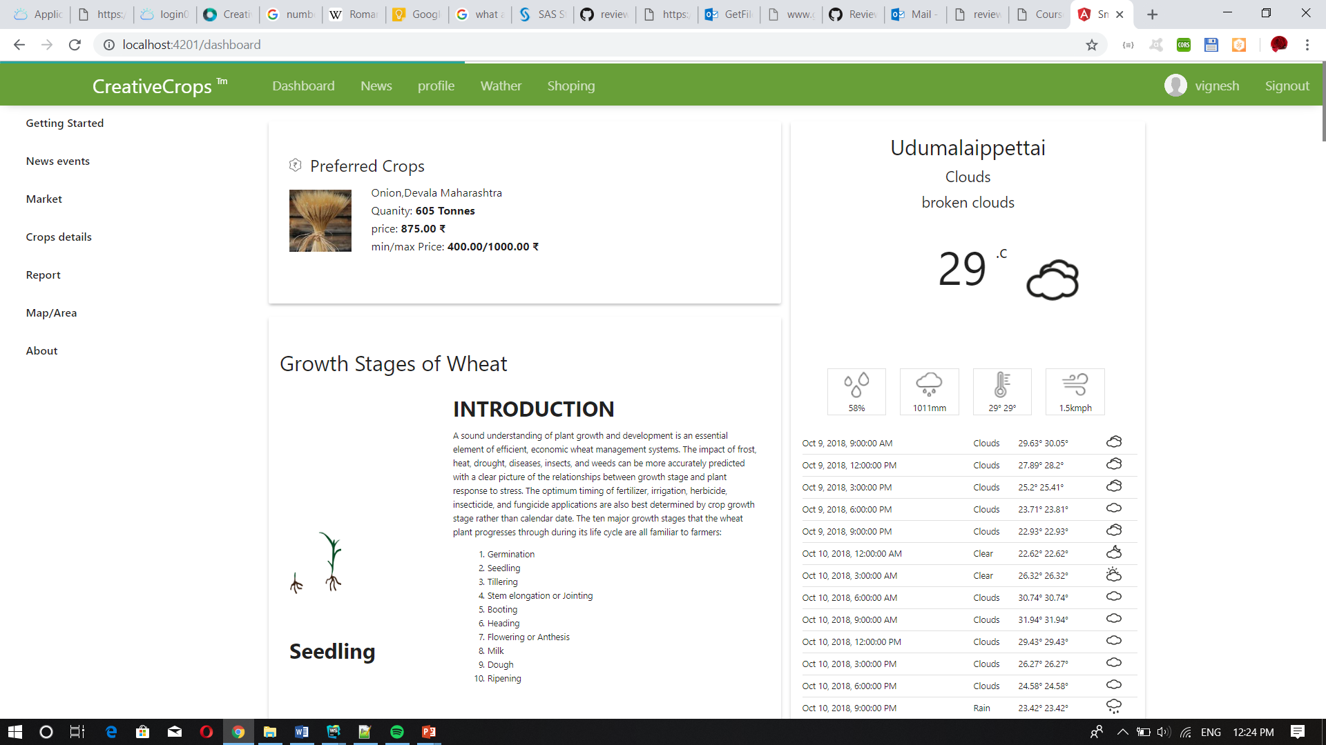

Slide 19
References
Aitkin, M. and Foxall, R. (2003). Statistical modelling of artificial neural networks using multi-layer perceptron. Statistics and Computing 13, 227–239.MathSciNetCrossRefGoogle Scholar
Alon, I., Qi, M. and Sadowski, R.J. (2001). Forecasting aggregate retail sales: a comparison of artificial neural networks and traditional methods. Journal of Retailer and Consumer Services 8, 147–156.CrossRefGoogle Scholar
Anders, U. and Korn, 0. (1999). Model selection in neural networks. Neural Networks 12, 309–323.CrossRefGoogle Scholar
Barat, C., Loaiza, H., Colle, E. and Lelandais, S. (2000). Neural and statistical classifiers. Can such approaches be complementary? In: Instrumentation and Measurement Technology Conference, Vol. 3, pp. 1480–1486.Google Scholar
Bastos Cavalcante, R. and Ludemir, T.B. (2001). Design of neural networks for time series prediction using case-initialized genetic algorithms. In: Proceedings 8th International Conference on Neural Information Processing, pp. 382–387.Google Scholar
Benediktsson, J.A. and Swain, P.H. (1990). Neural network approaches versus statistical methods in classification of multisource remote sensing data. IEEE Trans. on Geoscience and Remote Sensing 28 (4), 540–552.CrossRefGoogle Scholar

Slide 20
Bernier, J.L., Gonzalez, J., Canas, A. and Diaz, A.F. (2002). Evaluating the impact of multiplicative input perturbations on radial basis function networks. In: European Symposium on Artificial Neural Networks, pp. 237–244.Google Scholar
Bissessur, Y., Martin, E.B., Morris, A.J. and Kitson, P. (2000). Fault detection in hot steel rolling using neural networks and multivariate statistics. IEE Proc. Control Theory and Applications 147 (6), 633–640.CrossRefGoogle Scholar
Blough, D.K. and Anderson, K.K. (1994). A comparison of artificial neural networks and statistical analyses. Tech. Rep. Pacific Northwest National Laboratory, Richland, Washington, 1–38.CrossRefGoogle Scholar
Bouqata, B., Bensaid, A., Palliam, R. and Gómez Skarmeta, A.F. (2000). Time series prediction using crisp and fuzzy neural networks: a comparative study. In: Proceedings Conf. on Comp. Intelligence for Financial Engineering, pp. 170173.Google Scholar

Slide 21
THANK YOU

